Slide 1
Neural Network
Chul Min Yeum
Assistant Professor
Civil and Environmental Engineering
University of Waterloo, Canada
CIVE 497 – CIVE 700: Smart Structure Technology
Last updated: 2019-03-27

Slide 2
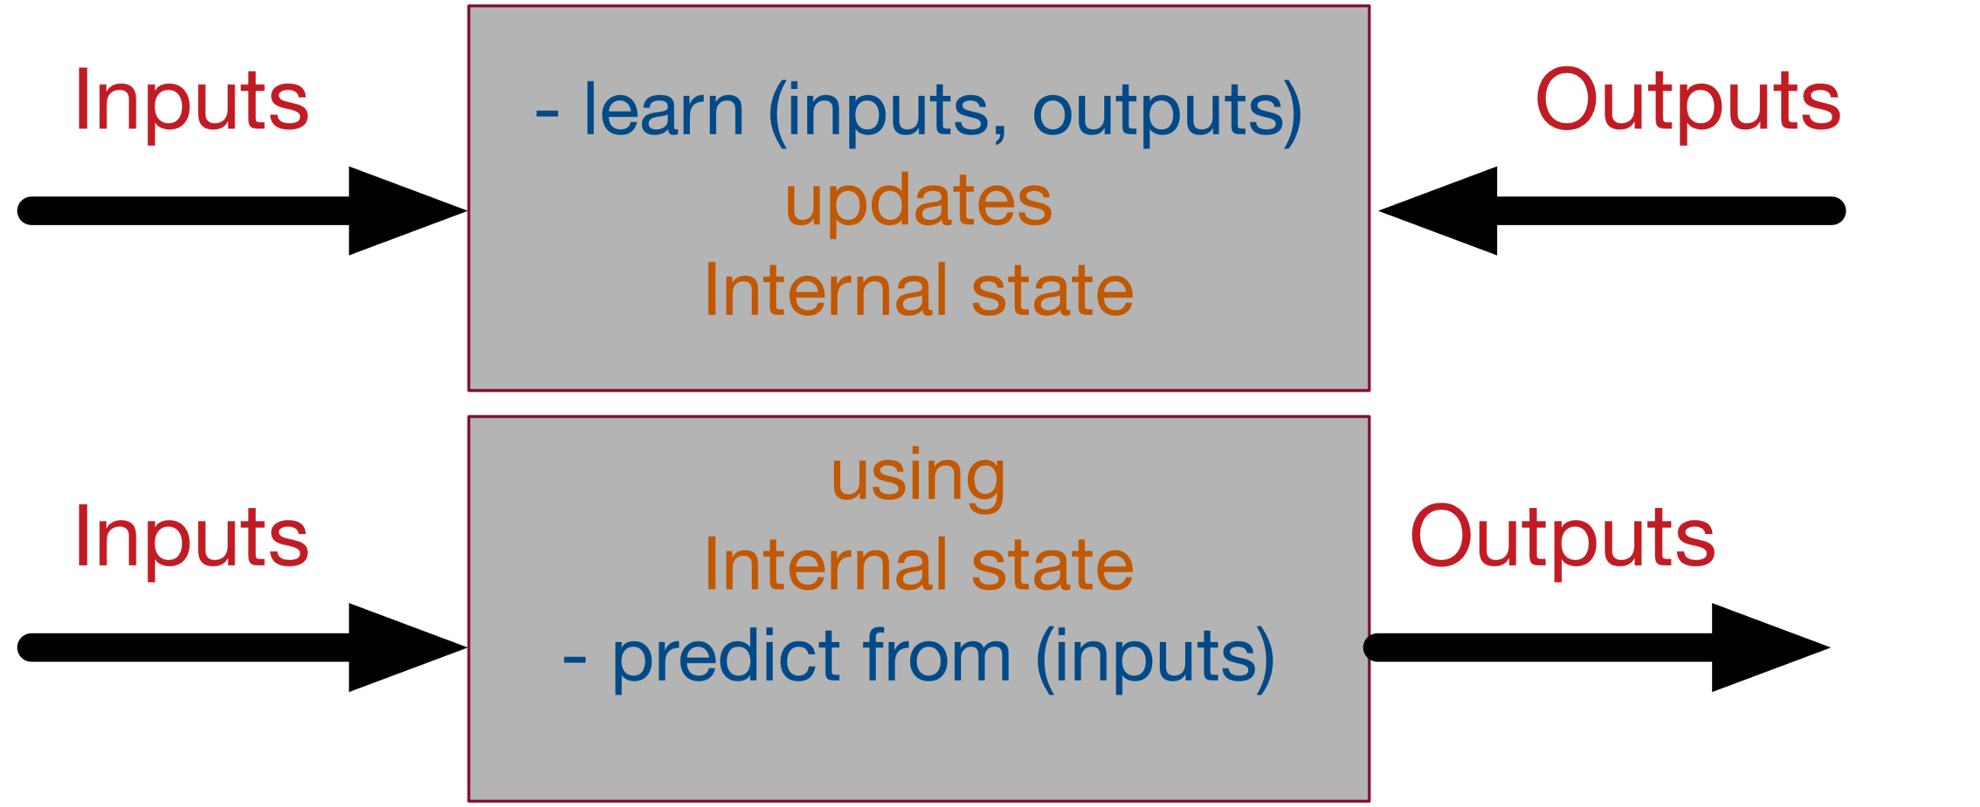
Supervised Neural Networks
https://medium.com/datathings/neural-networks-and-backpropagation-explained-in-a-simple-way-f540a3611f5e

Slide 3
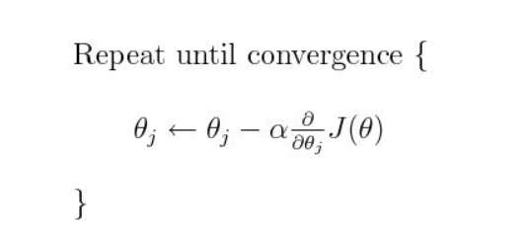
Gradient Descent
Gradient descent is an iterative machine learning optimization algorithm to reduce the cost function so that we have models that makes accurate predictions.
Cost function(J) or Loss function measures the difference between the actual output and predicted output from the model.
https://medium.com/@montjoile/an-introduction-to-gradient-descent-algorithm-34cf3cee752b

Slide 4
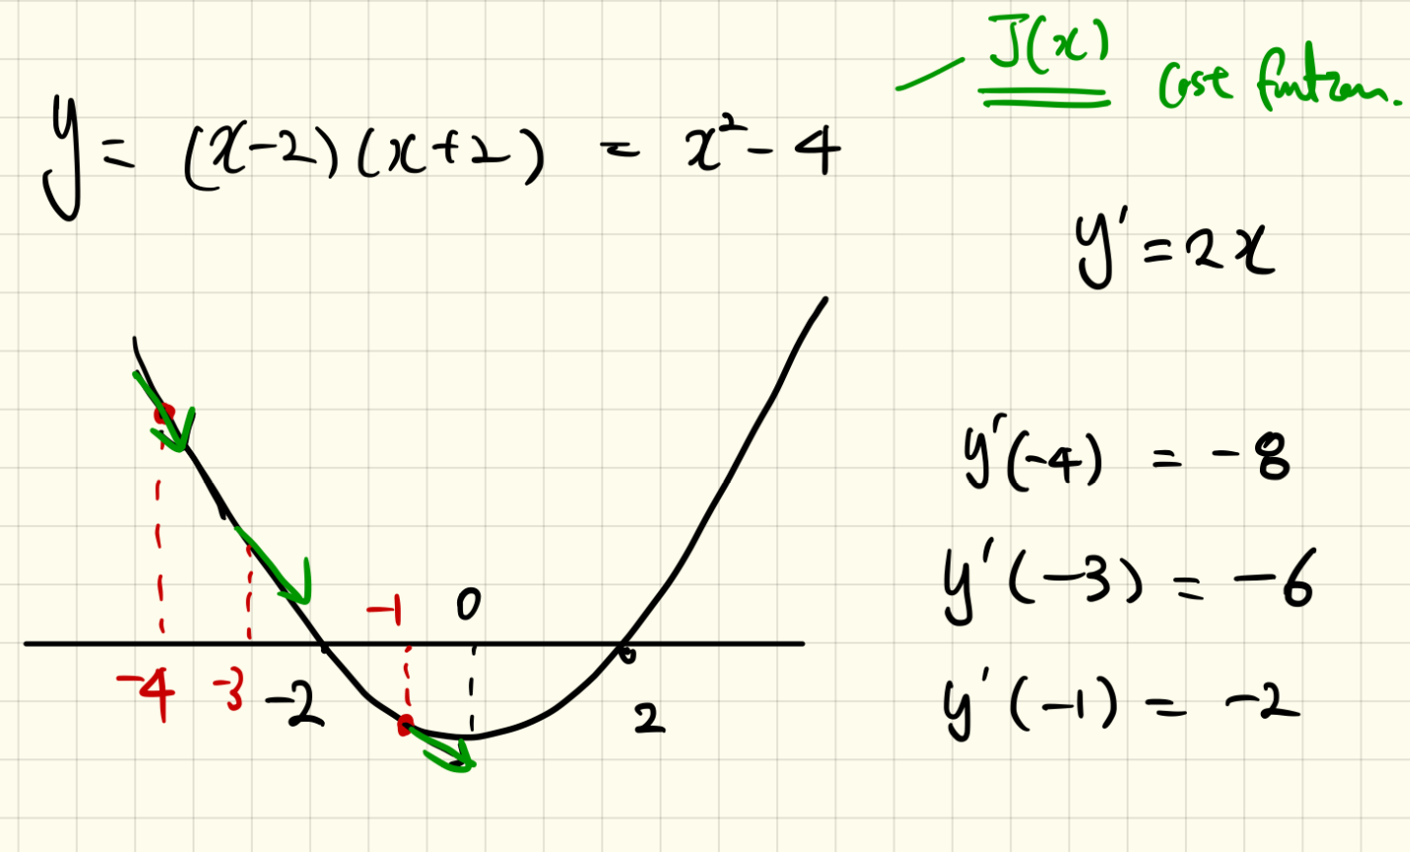
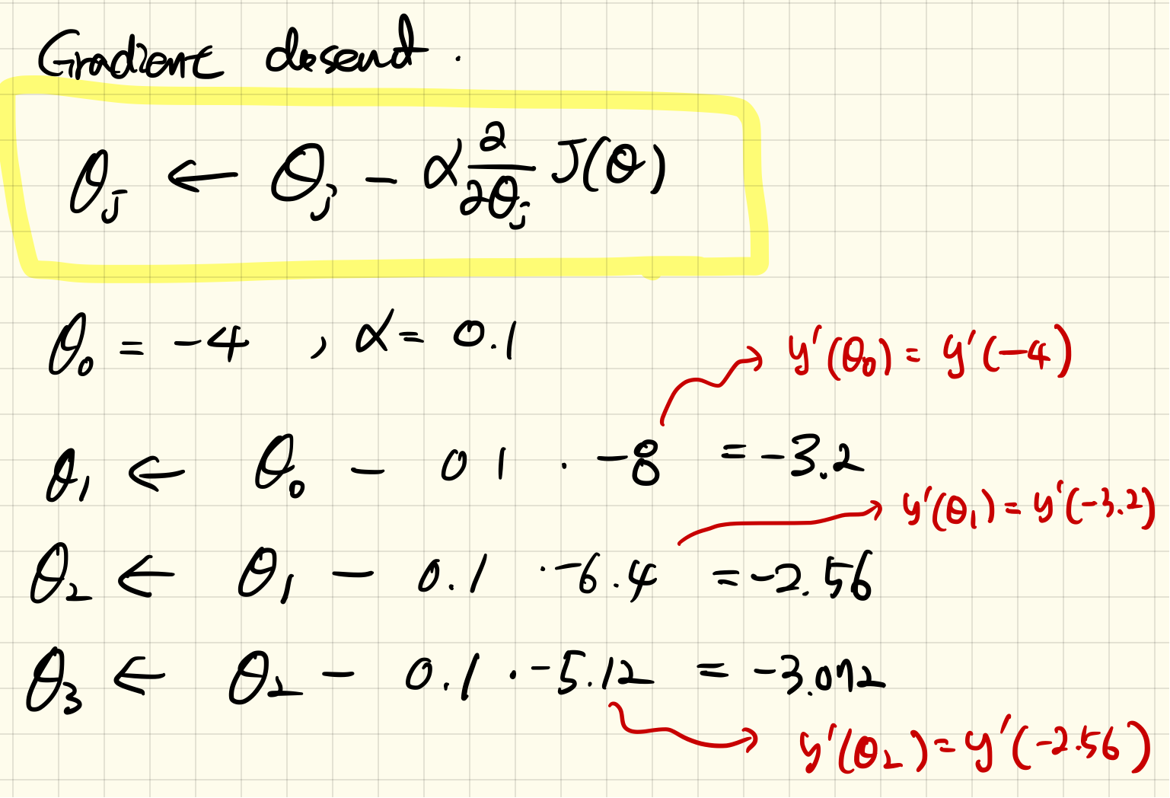
Example: Quadratic Function

Slide 5
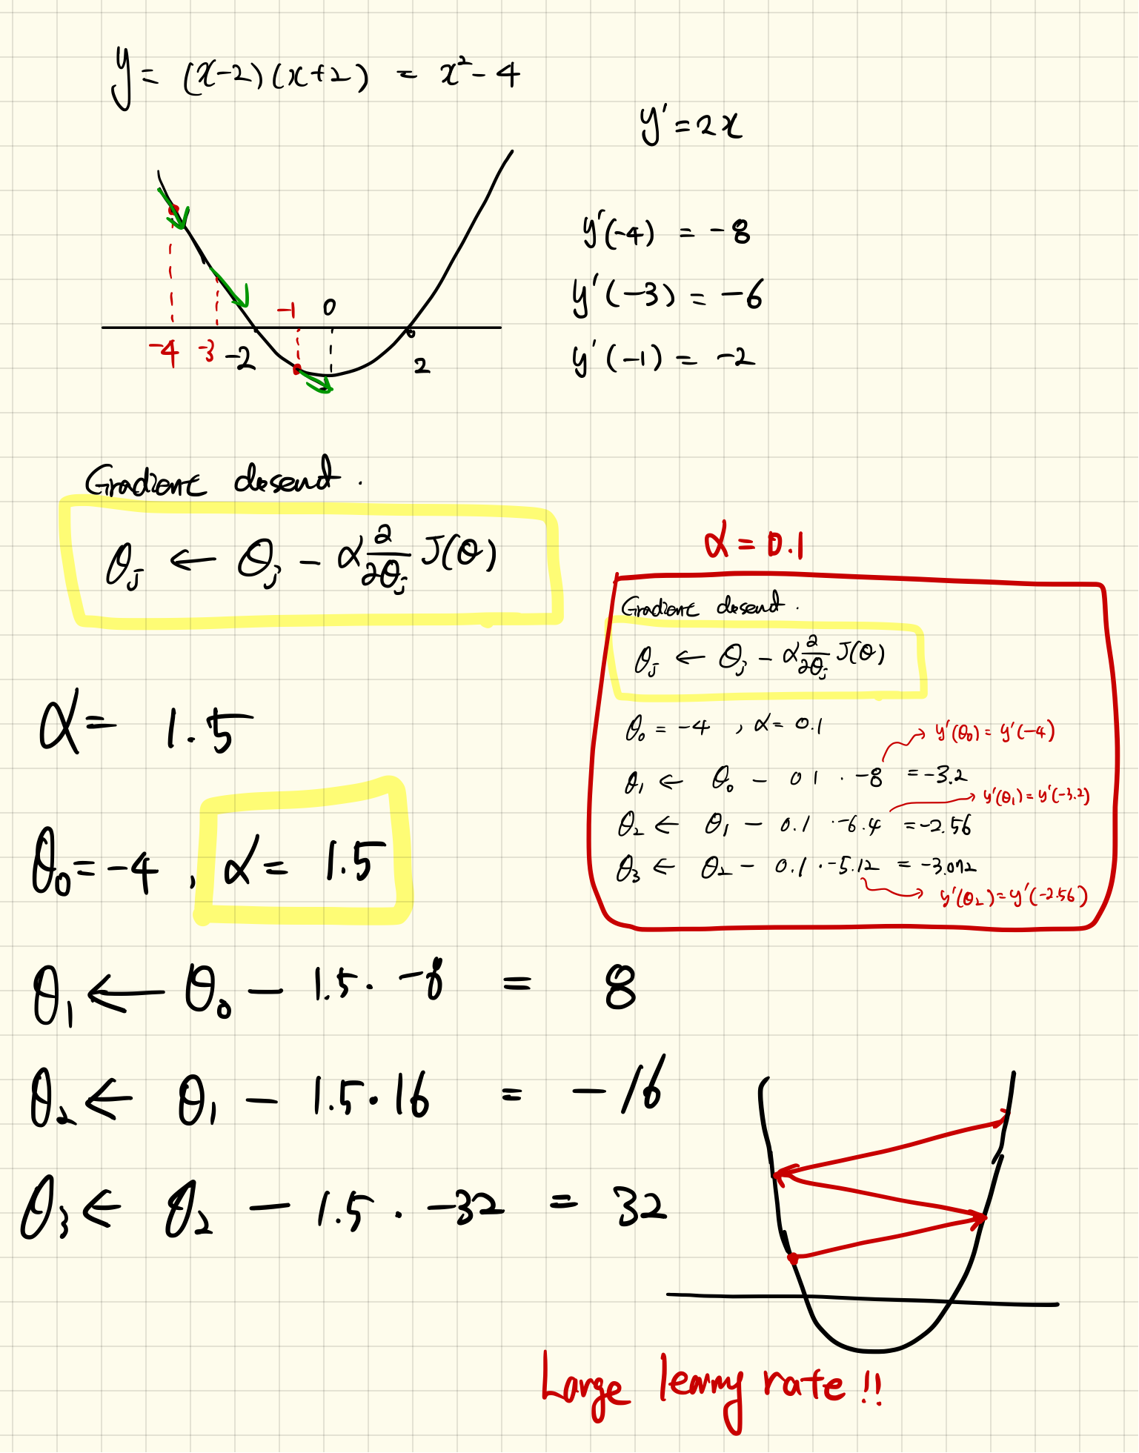
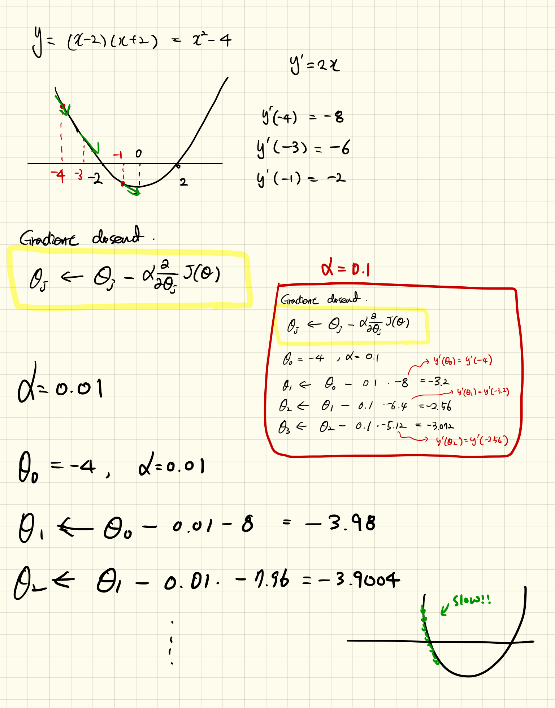
Example: Quadratic Function (Continue)

Slide 6
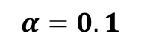
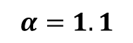
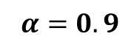
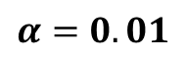
Example: Quadratic Function (Simulation)
10 iterations
$$α=0.1$$
$$α=0.01$$
$$α=1.1$$
$$α=0.9$$
See tutorials

Slide 7

Effect of Learning Rates

Slide 8
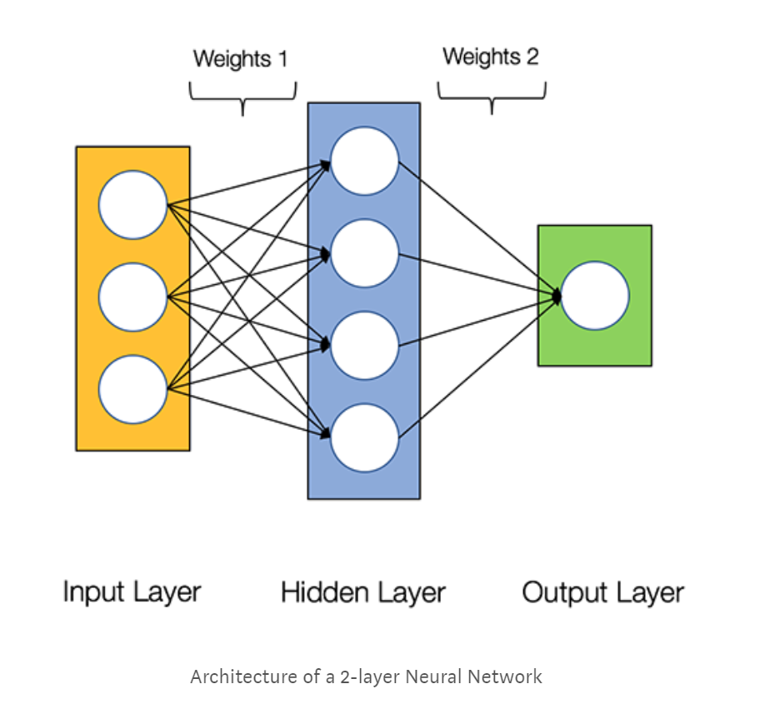
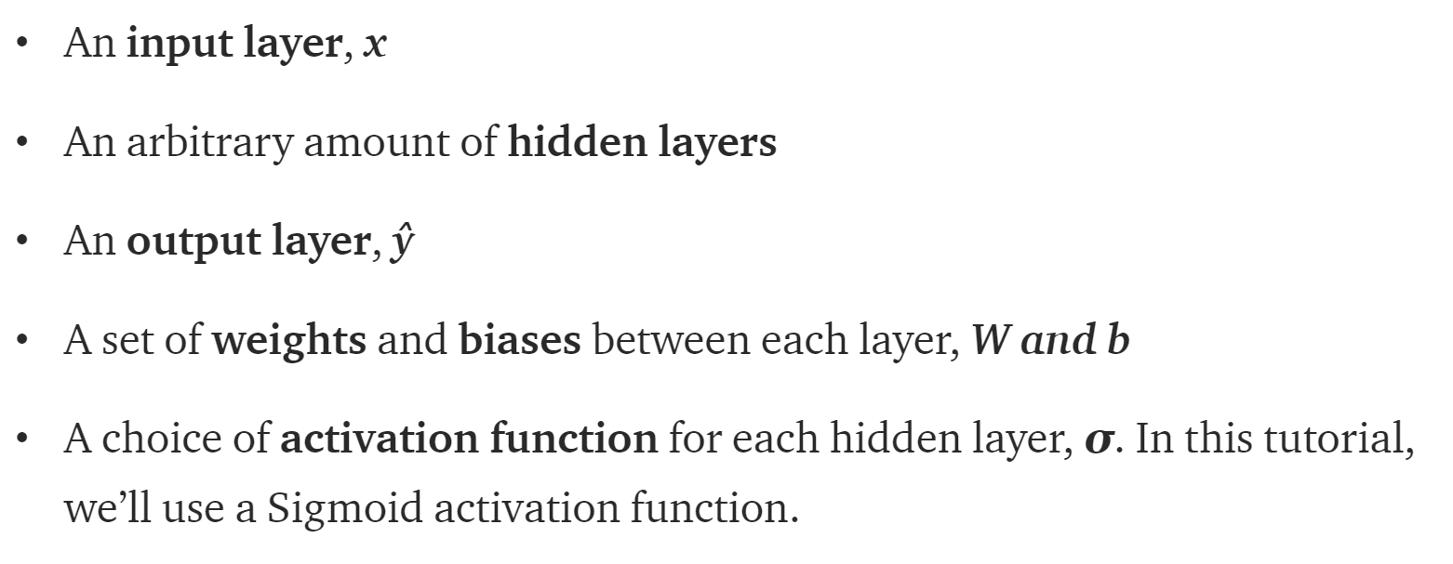
What’s a Neural Network
https://towardsdatascience.com/how-to-build-your-own-neural-network-from-scratch-in-python-68998a08e4f6

Slide 9
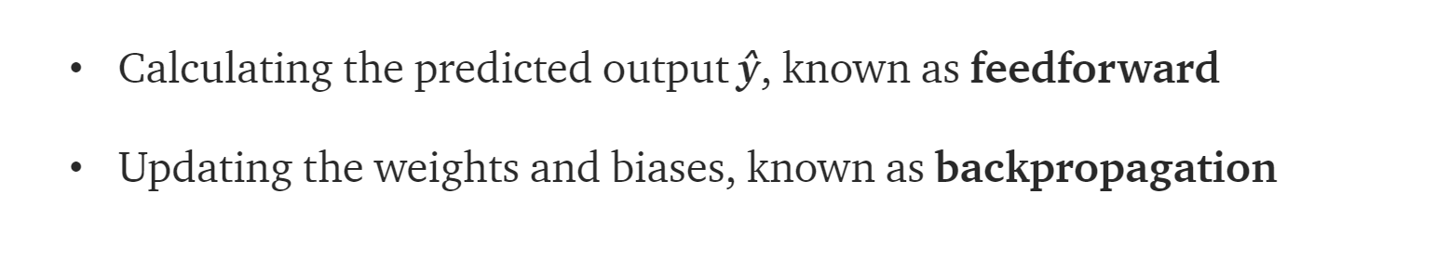
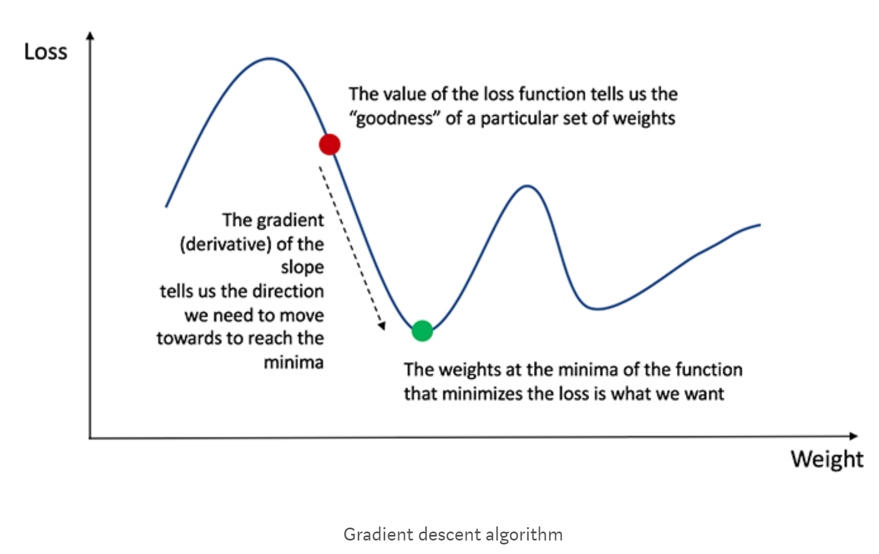
Training the Neural Network
Naturally, the right values for the weights and biases determines the strength of the predictions. The process of fine-tuning the weights and biases from the input data is known as training the Neural Network.
Our goal in training is to find the best set of weights and biases that minimizes the loss function.
https://towardsdatascience.com/how-to-build-your-own-neural-network-from-scratch-in-python-68998a08e4f6

Slide 10
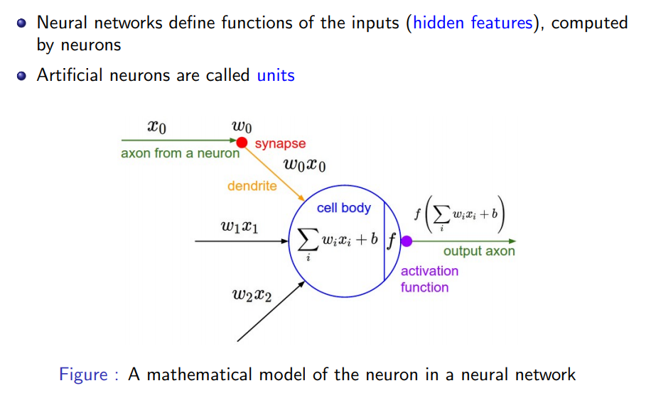
Mathematical Model of a Neuron

Slide 11
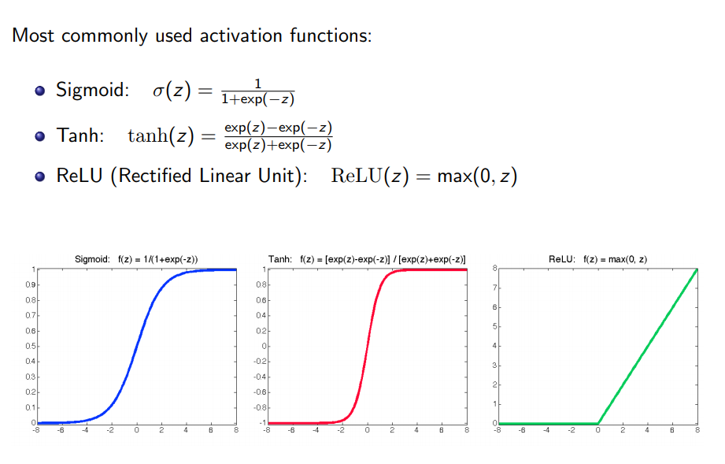
Activation Functions

Slide 12

Activation Functions and Their Derivatives
https://towardsdatascience.com/activation-functions-neural-networks-1cbd9f8d91d6

Slide 13
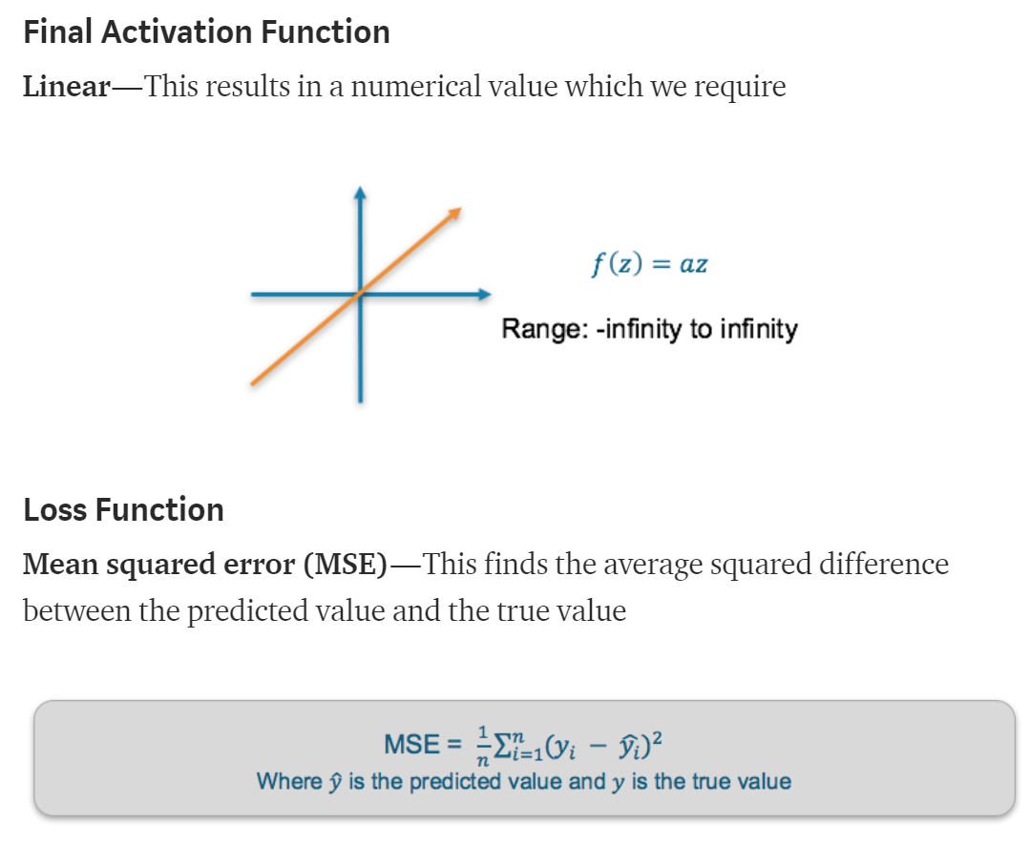
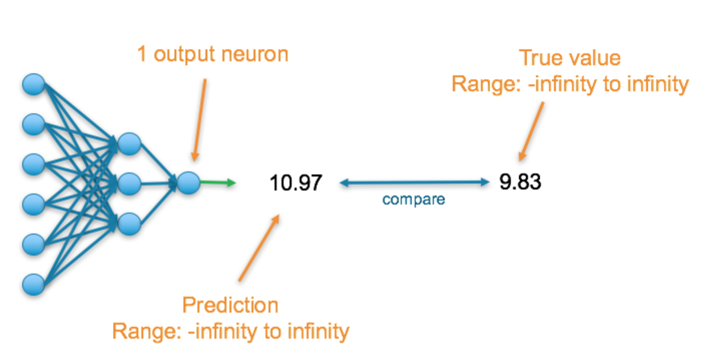
Loss Function
There are many available loss functions, and the nature of our problem should dictate our choice of loss function.
Regression
https://towardsdatascience.com/deep-learning-which-loss-and-activation-functions-should-i-use-ac02f1c56aa8
https://ml-cheatsheet.readthedocs.io/en/latest/loss_functions.html

Slide 14
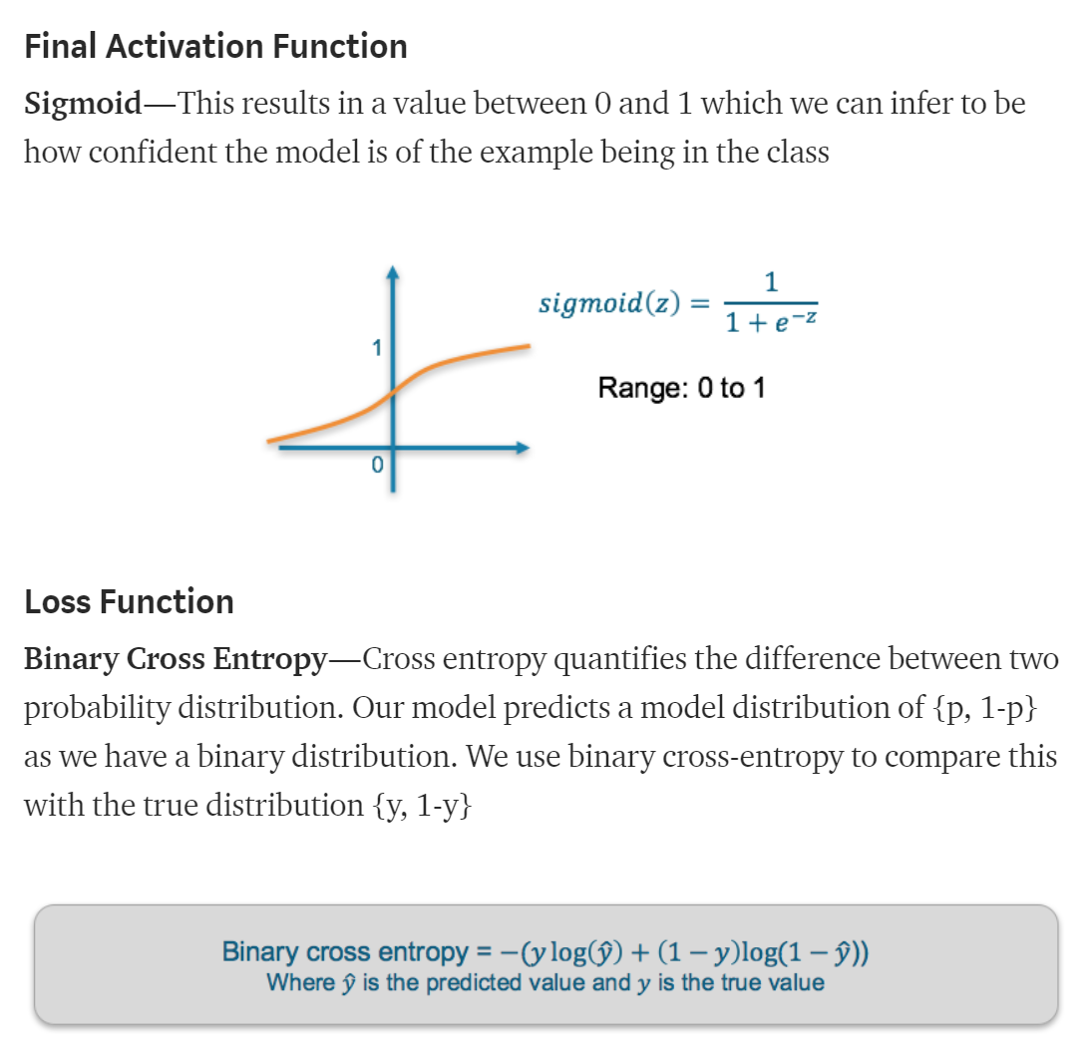
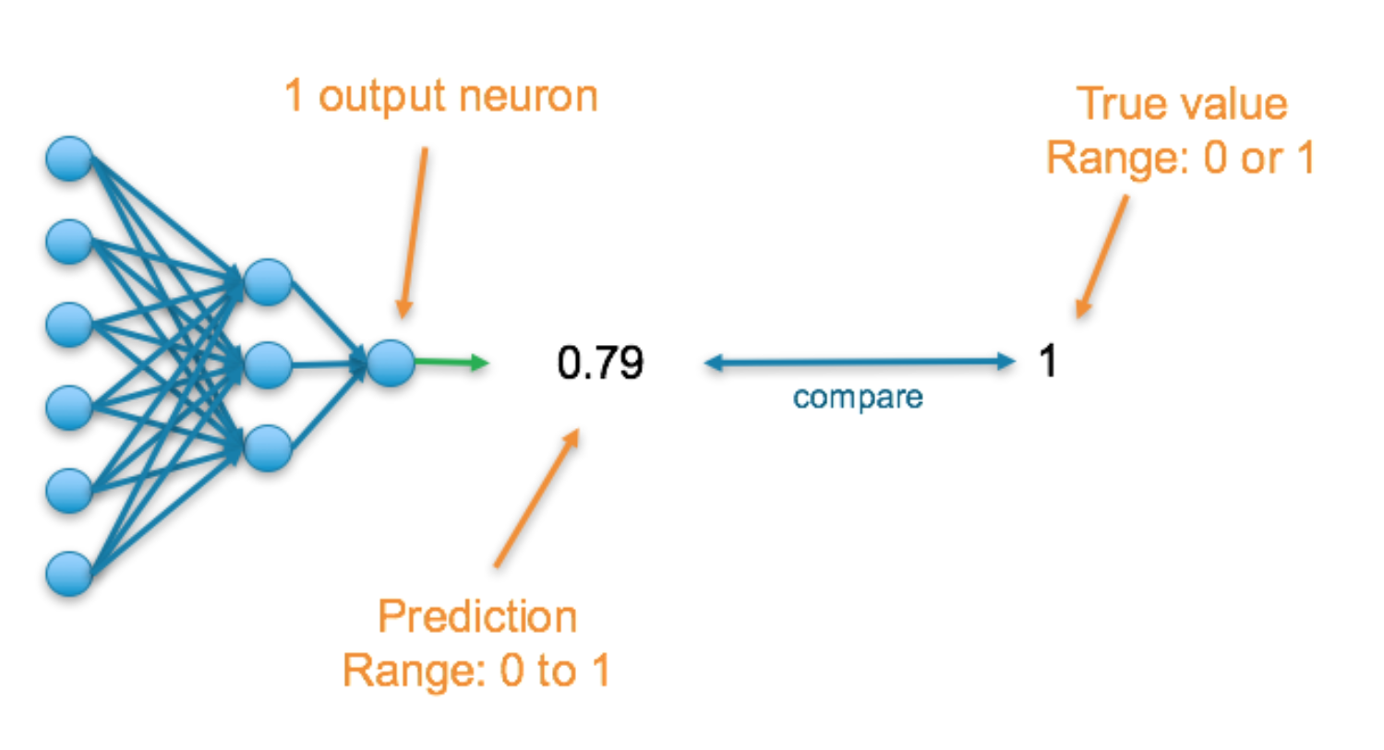
Loss Function (Continue)
https://towardsdatascience.com/deep-learning-which-loss-and-activation-functions-should-i-use-ac02f1c56aa8

Slide 15
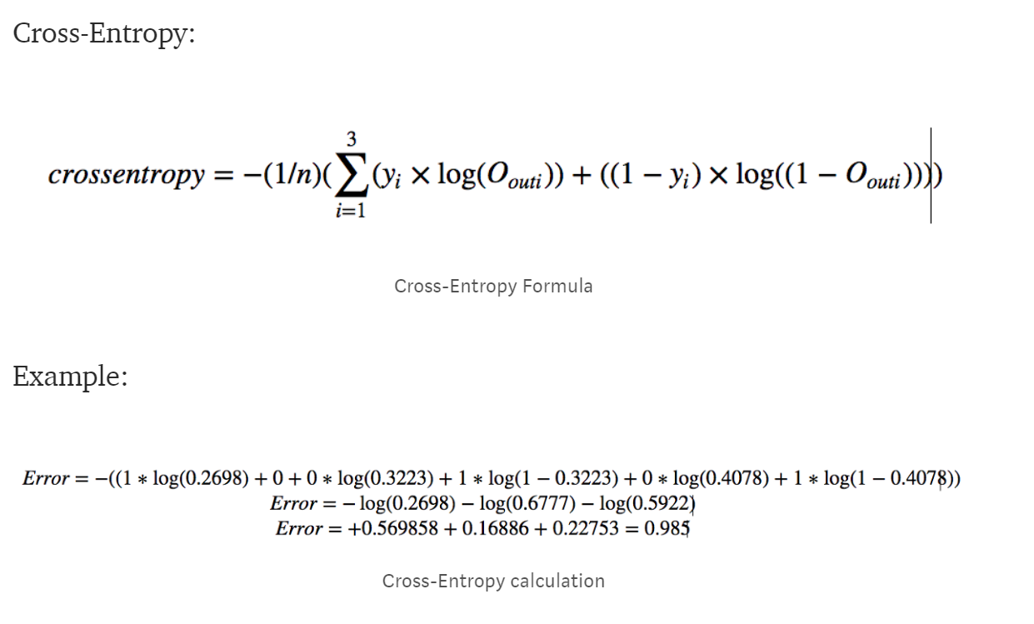
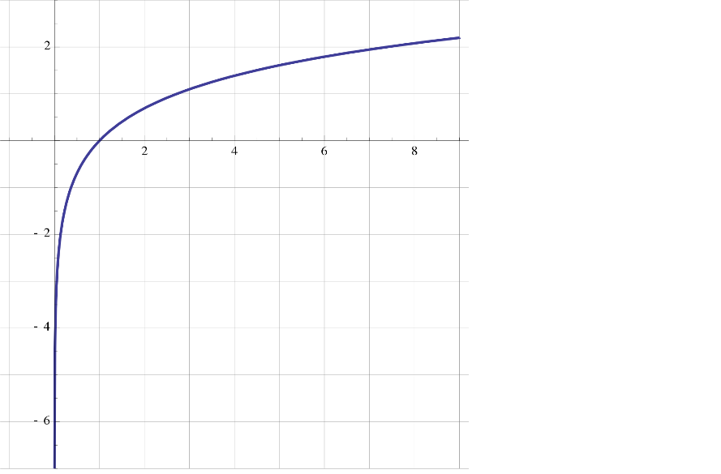
Cross Entropy
https://stackoverflow.com/questions/36515202/why-is-the-cross-entropy-method-preferred-over-mean-squared-error-in-what-cases

Slide 16
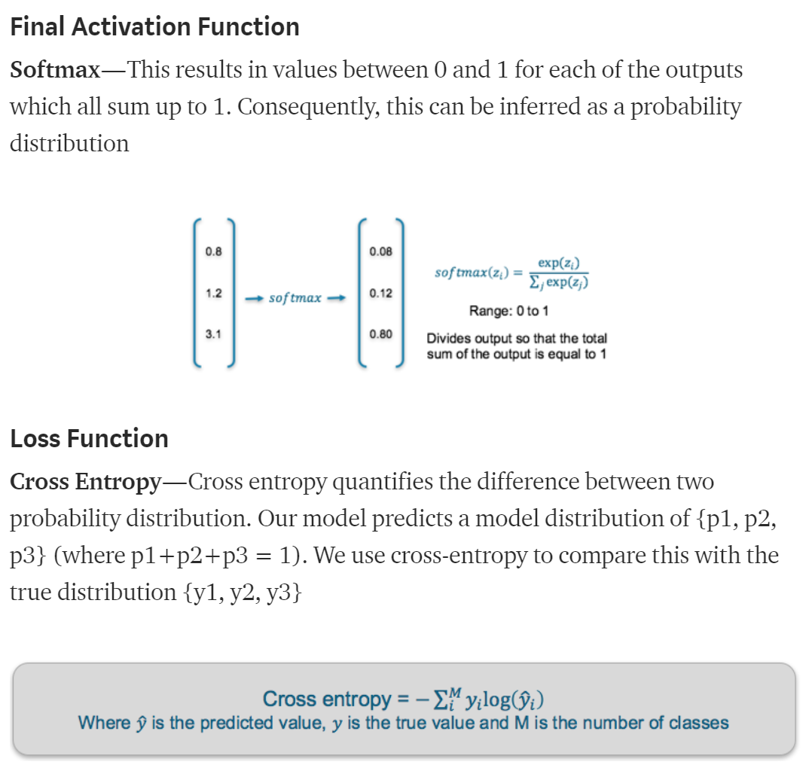
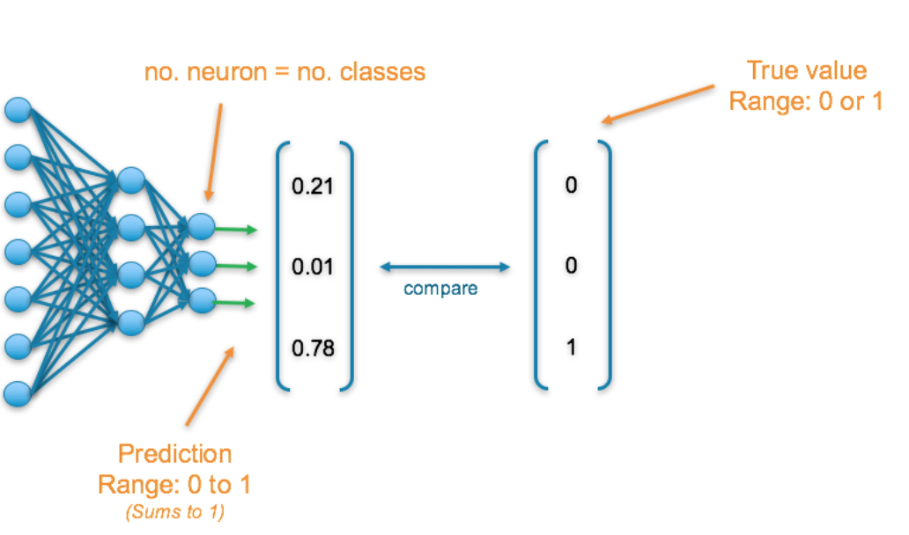
Loss Function (Continue)
https://towardsdatascience.com/deep-learning-which-loss-and-activation-functions-should-i-use-ac02f1c56aa8

Slide 17
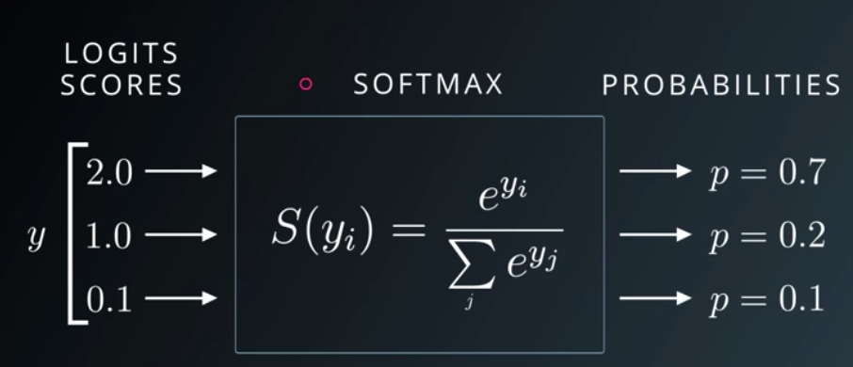
Softmax Function
https://medium.com/data-science-bootcamp/understand-the-softmax-function-in-minutes-f3a59641e86d

Slide 18
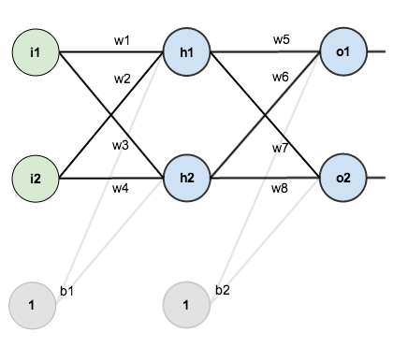
A Step-by-step Forward and Backward Propagation
https://mattmazur.com/2015/03/17/a-step-by-step-backpropagation-example/
One hidden layer (two hidden neurons)
Two output neuron
Two input neuron
Activation function: Logistic function
two input → two output

Slide 19
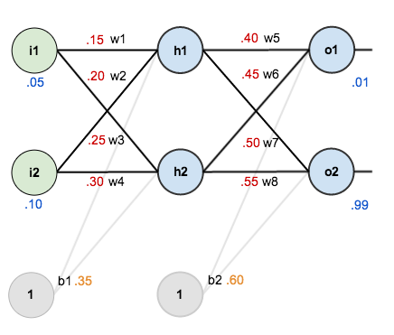
Initial Weights, Biases, and Training Inputs/Outputs

Slide 20
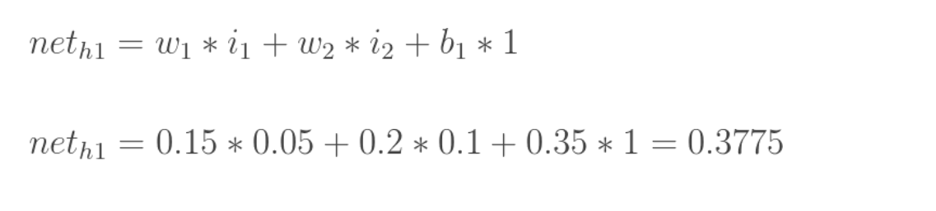
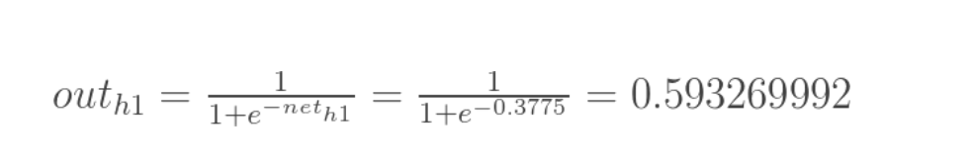
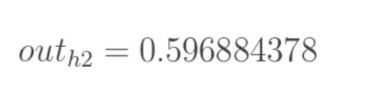
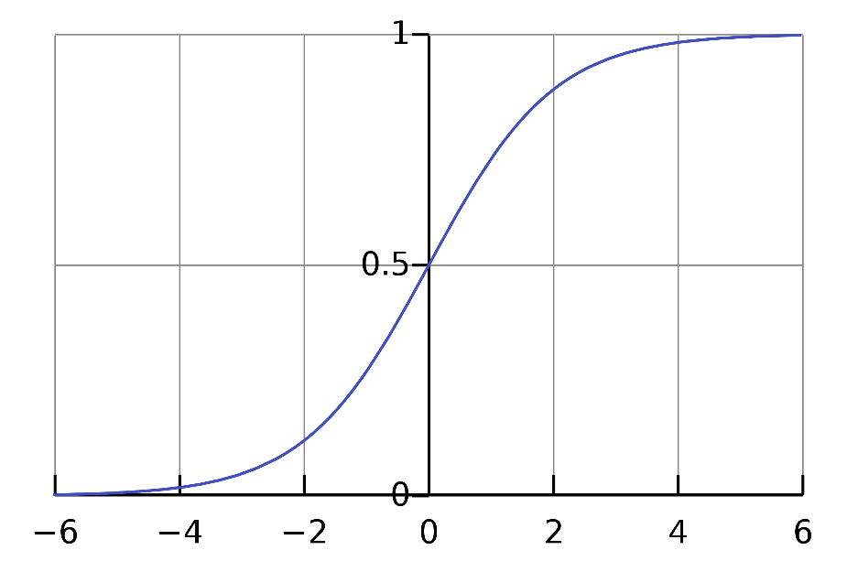
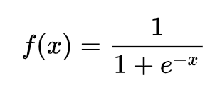
Forward Pass
Logistic function (sigmoid curve)

Slide 21
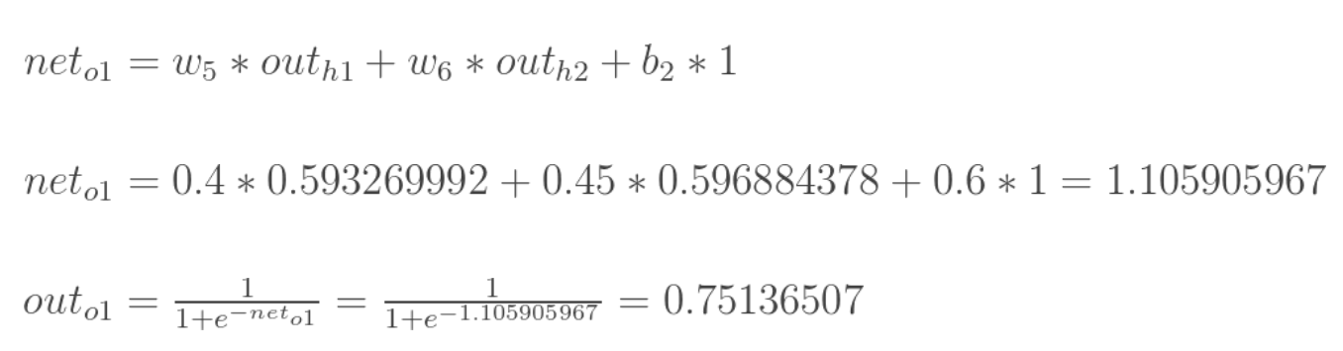
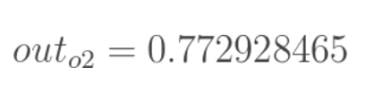
Forward Pass (Continue)
0.3775
0.593
1.106
0.751
0.393
0.596
1.224
0.773

Slide 22
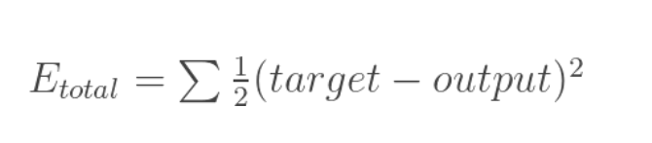
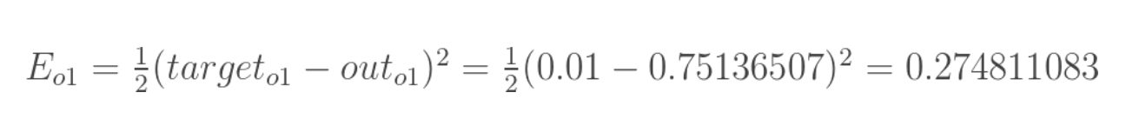
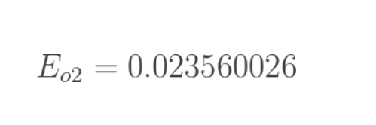
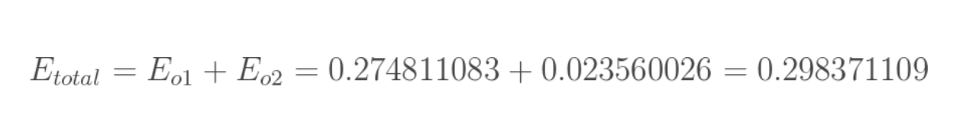
Calculating the Total Error
0.3775
0.593
1.106
0.751
0.393
0.596
1.224
0.773
End of a forward pass

Slide 23
Backward Pass
0.3775
0.593
1.106
0.751
Our goal with backpropagation is to update each of the weights in the network so that they cause the actual output to be closer the target output, thereby minimizing the error for each output neuron and the network as a whole. Our goal is to make the values in the red boxes 0.01 and 0.99, respectively by changing (updating) the weights.
0.393
0.596
1.224
0.773

Slide 24
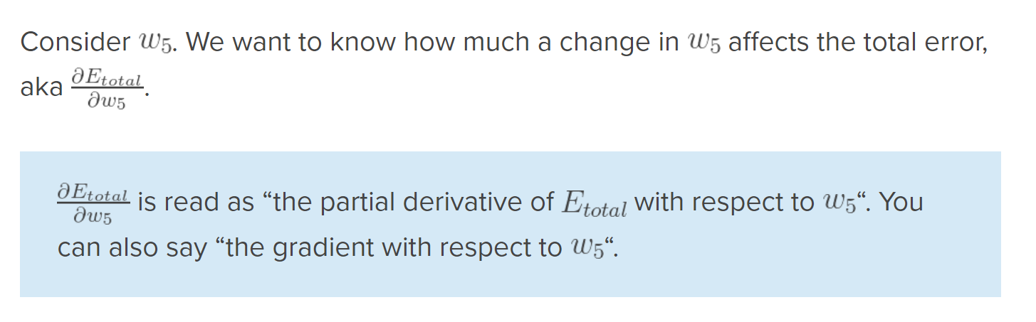
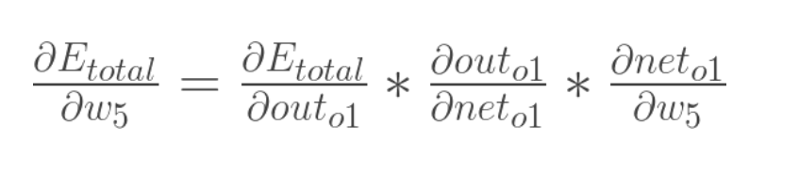
Output Layer
Chain rule

Slide 25
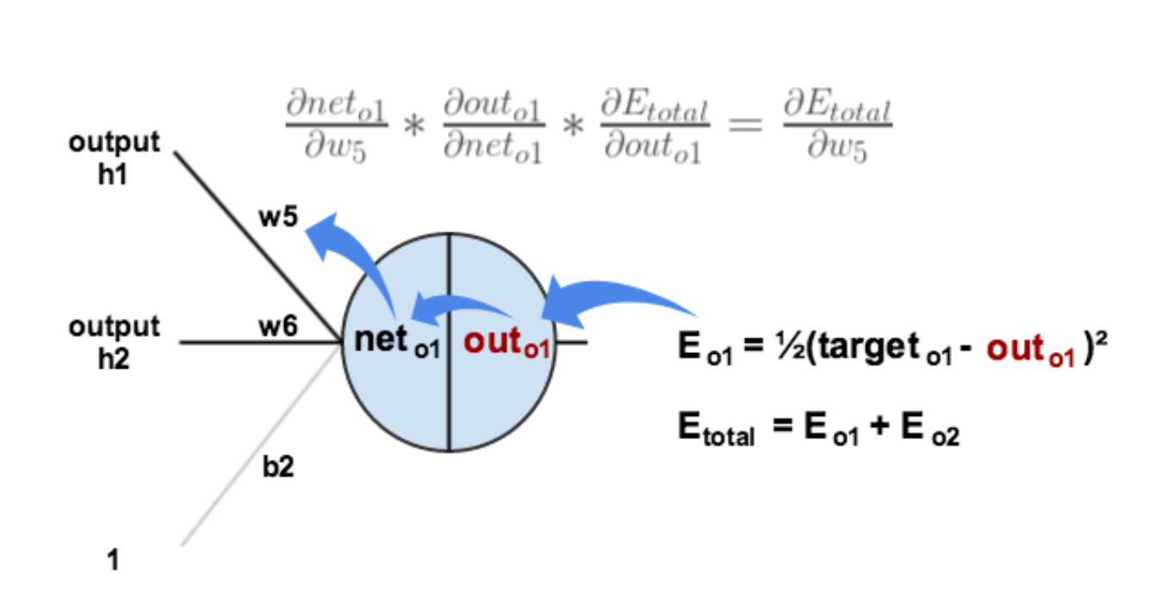
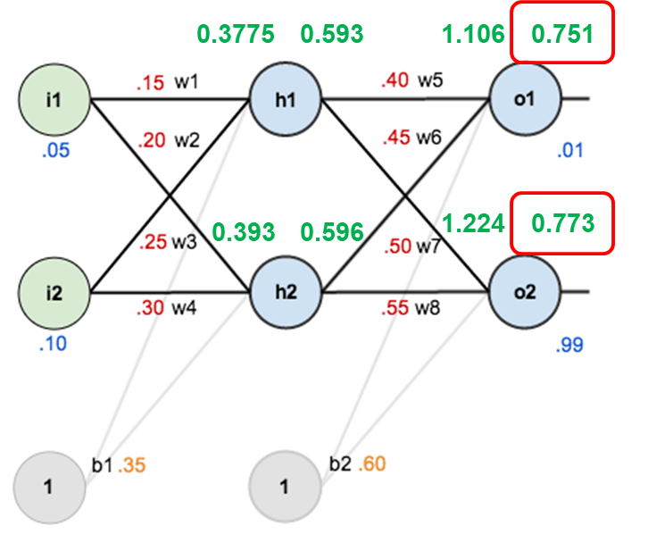
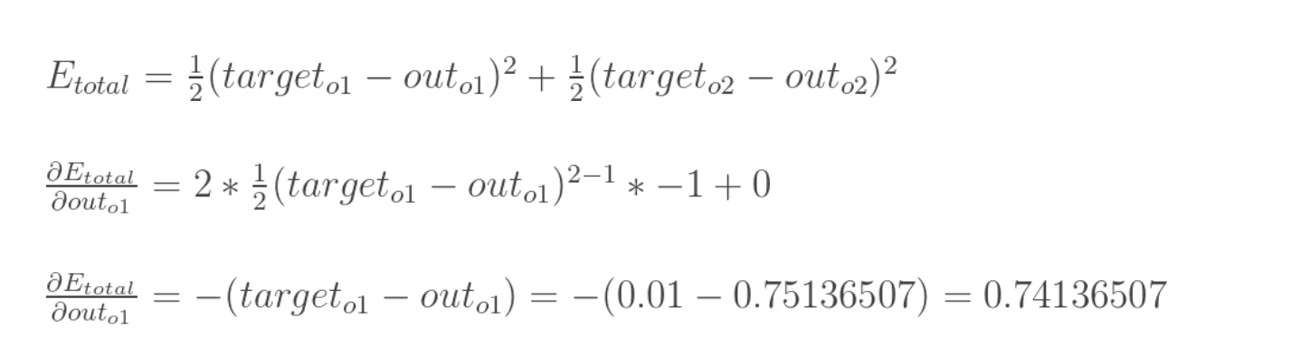
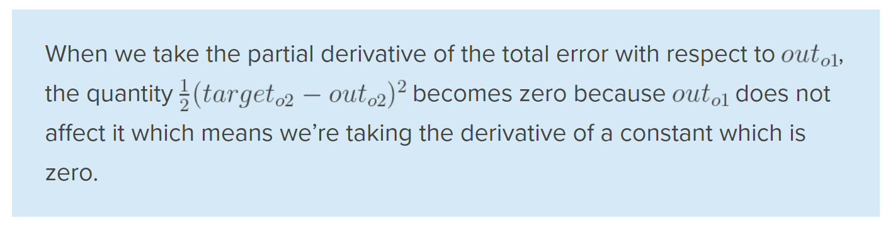
Output Layer (Continue)

Slide 26
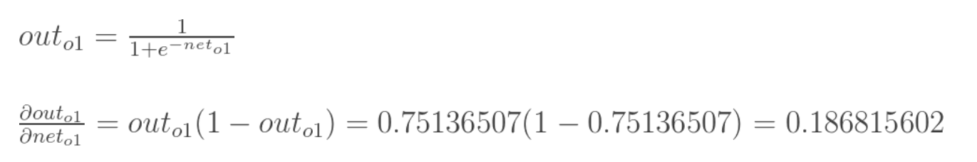
Output Layer (Continue)

Slide 27
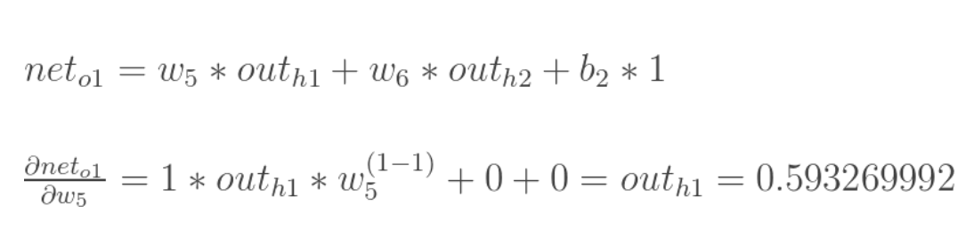
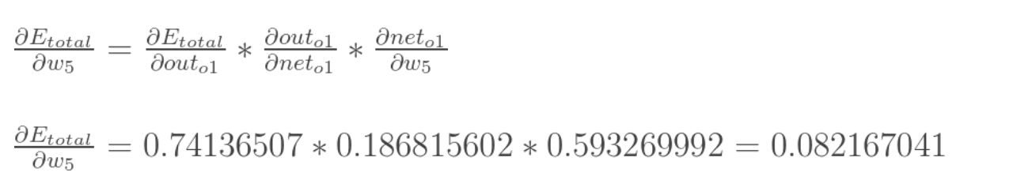
Output Layer (Continue)

Slide 28
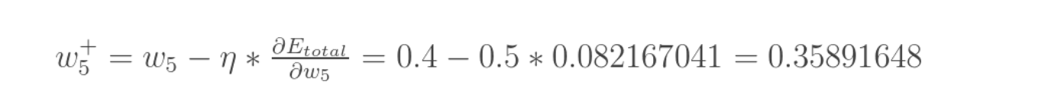
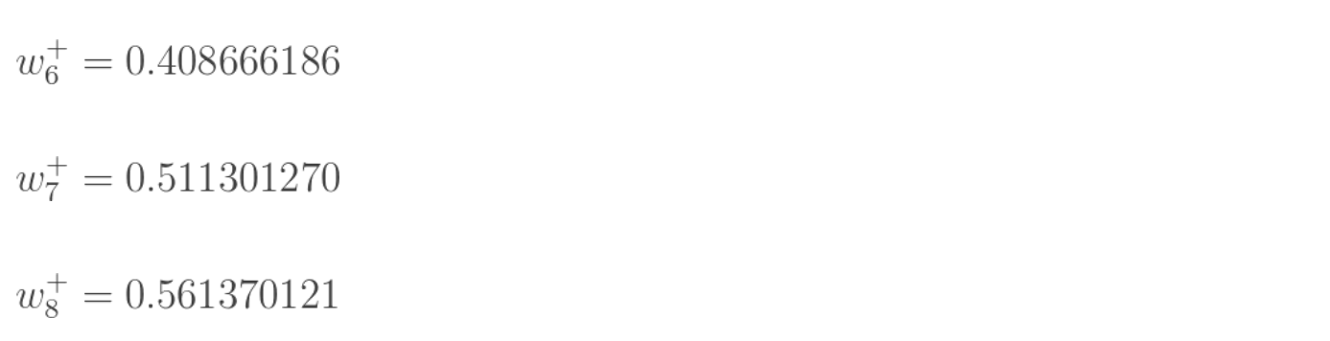
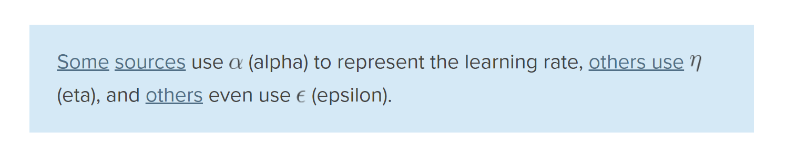
Output Layer (Continue)

Slide 29

Hidden Layer
W1, W2, W3, and W4 contribute both the E_{o1} and E_{o2}

Slide 30
What Did We Compute?
o2
o2
7
o2
o2
7
o2

Slide 31




Hidden Layer (Continue)
=

Slide 32



Hidden Layer (Continue)
=

Slide 33


Hidden Layer (Continue)

Slide 34

Hidden Layer (Continue)

Slide 35


Complete One Iteration (Forward and Back Propagation)

Slide 36


Another Example: A Step-by-step Forward and Backward Propagation
Two hidden layer
Three hidden neuron in each layer
Three output neuron
Three input neuron
Different activation functions
Three input → Three output
https://medium.com/@14prakash/back-propagation-is-very-simple-who-made-it-complicated-97b794c97e5c

Slide 37



Derivatives of Activation Functions

Slide 38

Initializing Network

Slide 39


Forward Propagation: Layer-1

Slide 40


Forward Propagation: Layer-2

Slide 41


Forward Propagation: Layer-3

Slide 42
Cross Entropy
https://stackoverflow.com/questions/36515202/why-is-the-cross-entropy-method-preferred-over-mean-squared-error-in-what-cases

Slide 43


Back Propagation: Layer-2 − Output

Slide 44

Back Propagation: Layer-2 − Output (Continue)

Slide 45

Back Propagation: Layer-2 − Output (Continue)

Slide 46

Back Propagation: Layer-2 − Output (Continue)

Slide 47


Back Propagation: Layer-2 − Output (Continue)

Slide 48


Back Propagation: Layer-1 − Layer 2

Slide 49


Back Propagation: Layer-1 − Layer 2 (Continue)

Slide 50


Back Propagation: Layer-1 − Layer 2 (Continue)

Slide 51


Back Propagation: Layer-1 − Layer 2 (Continue)

Slide 52




Gradient Descent Variants
Batch gradient descent: Batch Gradient Descent is when we sum up over all examples on each iteration when performing the updates to the parameters. Therefore, for each update, we have to sum over all examples:
Mini-batch gradient descent: Instead of going over all examples, Mini-batch Gradient Descent sums up over lower number of examples based on the batch size. Therefore, learning happens on each mini-batch of b examples:
Stochastic gradient descent: Instead of going through all examples, Stochastic Gradient Descent (SGD) performs the parameters update on each example (x^{i},y^{i}). Therefore, learning happens on every example:
https://towardsdatascience.com/gradient-descent-algorithm-and-its-variants-10f652806a3
https://medium.com/@montjoile/an-introduction-to-gradient-descent-algorithm-34cf3cee752b

Slide 53



Epoch vs Batch Size vs Iterations
https://towardsdatascience.com/epoch-vs-iterations-vs-batch-size-4dfb9c7ce9c9

Slide 54

Example: Neural Network Playground
http://playground.tensorflow.org/

Slide 55

Tutorial: Binary Classification (Gaussian)

Slide 56

Tutorial: Binary Classification (Circle)

